Slide 1
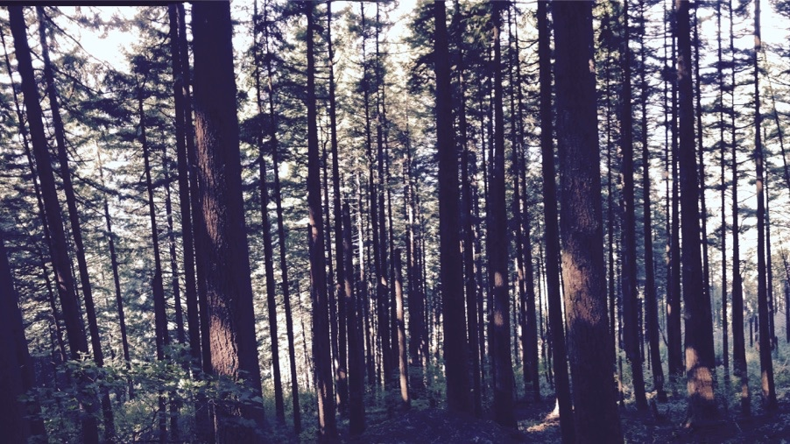
Simulating photosynthetic acclimation using least-cost optimality
Nick Smith & Helen Scott
Department of Biological Sciences
Texas Tech University

Slide 2
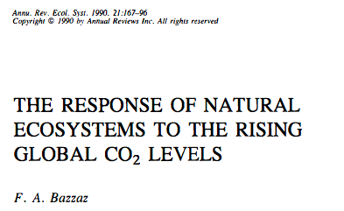
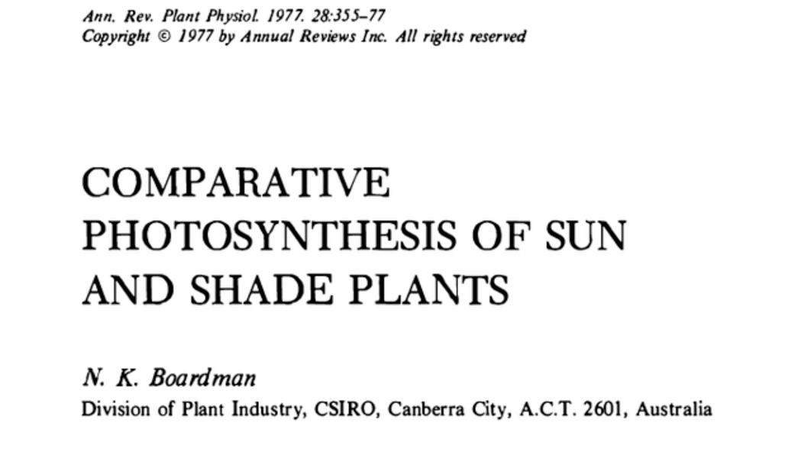
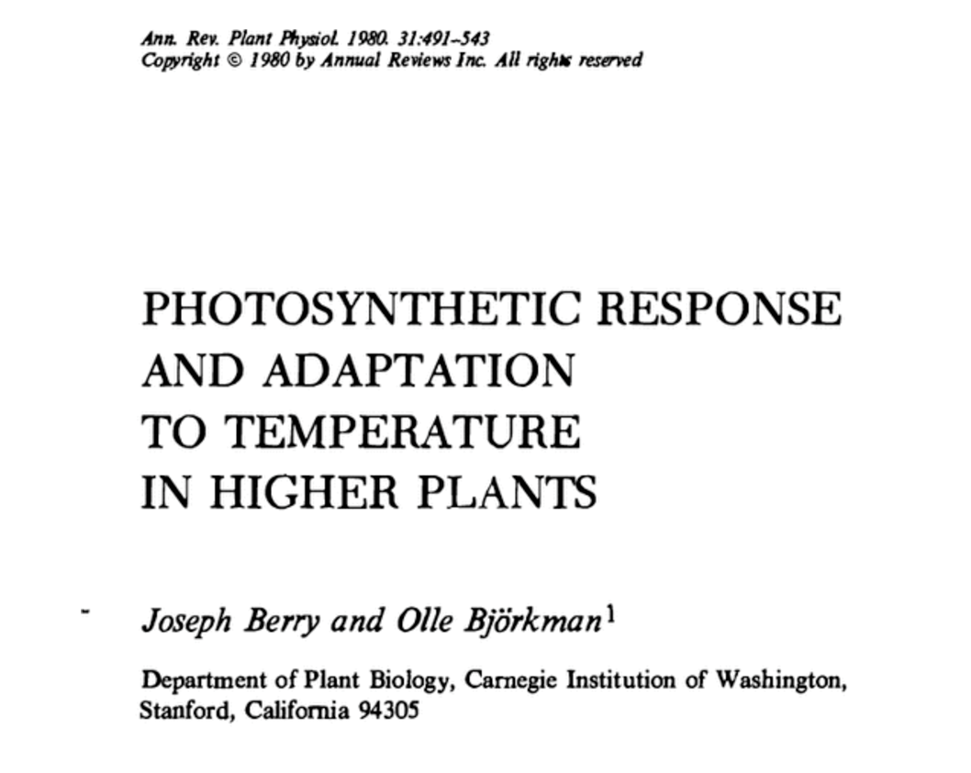
Photosynthetic acclimation is ubiquitous and well known…
nick.smith@ttu.edu; @nick_greg_smith
Temperature: Berry & Björkman (1980)
CO₂: Bazzaz (1990)
Light: Boardman (1977)

Slide 3
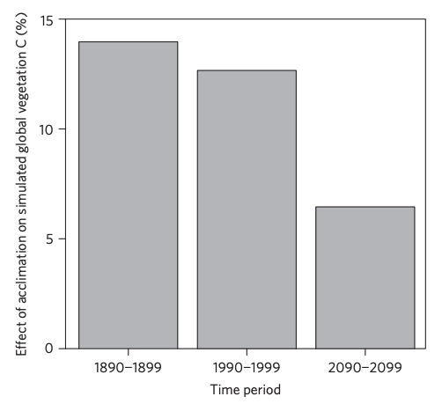
…and can possibly impact carbon cycling and climate
nick.smith@ttu.edu; @nick_greg_smith
Acclimation increase future C storage by ~6%
Acclimation alters future temperature by >1°C
Smith et al. (2017) Nature Climate Change
Smith et al. (2017) JAMES

Slide 4
Here’s the problem: No theoretical model for photosynthetic acclimation exists
nick.smith@ttu.edu; @nick_greg_smith

Slide 5
So, we developed a mechanistic model of photosynthetic acclimation Based on least cost optimization and the first principles of plant physiological theory
nick.smith@ttu.edu; @nick_greg_smith

Slide 6
Least cost theory
nick.smith@ttu.edu; @nick_greg_smith
Maintain fastest rate of photosynthesis at the lowest cost (water and nutrient use)
Wright et al. (2003) American Naturalist

Slide 7
Optimal photosynthesis
nick.smith@ttu.edu; @nick_greg_smith
Photosynthesis = f{stomatal conductance,
photosynthetic biochemistry}

Slide 8
Optimal photosynthesis
nick.smith@ttu.edu; @nick_greg_smith
Photosynthesis = f{stomatal conductance,
photosynthetic biochemistry}
Must predict optimal rates of both

Slide 9
Optimal photosynthesis
nick.smith@ttu.edu; @nick_greg_smith
Photosynthesis = f{stomatal conductance,
photosynthetic biochemistry}

Slide 10
Optimal photosynthesis
nick.smith@ttu.edu; @nick_greg_smith
Photosynthesis = f{stomatal conductance,
photosynthetic biochemistry}
OTPIMAL CONDUCTANCE IS NOW INCLUDED IN MANY MODELS
e.g., Prentice et al. (2014), Medlyn et al. (2011)

Slide 11
Optimal photosynthesis
nick.smith@ttu.edu; @nick_greg_smith
Photosynthesis = f{stomatal conductance,
photosynthetic biochemistry}

Slide 12
Biochemistry optimization: Coordination hypothesis
nick.smith@ttu.edu; @nick_greg_smith
Optimal setup = equal limitation by all factors

Slide 13
Optimally: electron transport-limited (A_{j}) = Rubisco-limited (A_{c})
nick.smith@ttu.edu; @nick_greg_smith
A_{j} = A_{c}
Smith et al. (2019)

Slide 14
Optimally: electron transport-limited (A_{j}) = Rubisco-limited (A_{c})
nick.smith@ttu.edu; @nick_greg_smith
A_{j} = A_{c}
A_{j} = f{J_{max}, light, T, CO₂}
A_{c} = f{V_{cmax}, T, CO₂}
Smith et al. (2019)

Slide 15
nick.smith@ttu.edu; @nick_greg_smith
Can rearrange the formulas to solve for acclimated traits
V_{cmax}
J_{max}
V_{pmax} (C4)
Smith et al. (2019)

Slide 16
nick.smith@ttu.edu; @nick_greg_smith
V_{cmax}
J_{max}
V_{pmax} (C4)
= f{average env. conditions}
Smith et al. (2019)

Slide 17
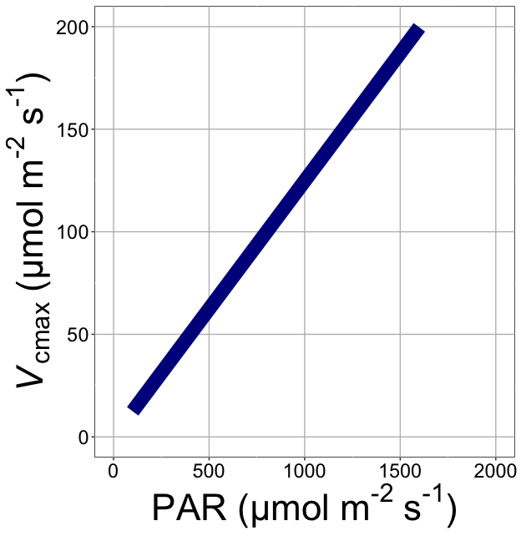
nick.smith@ttu.edu; @nick_greg_smith
V_{cmax} increases with light because of greater electron transport
Smith et al. (2019)

Slide 18
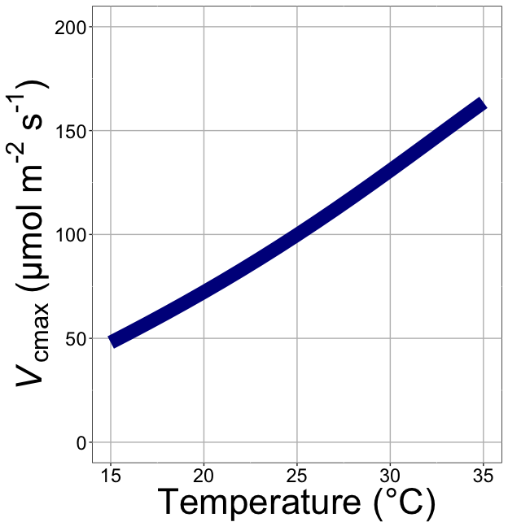
nick.smith@ttu.edu; @nick_greg_smith
V_{cmax} increases with temperature because of greater electron transport and photorespiration
Smith et al. (2019)

Slide 19
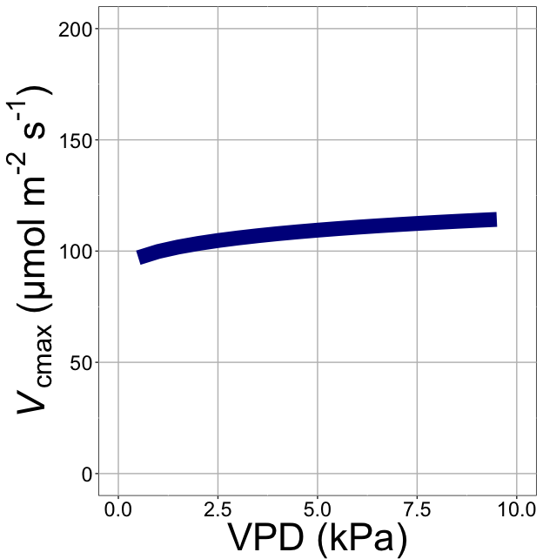
nick.smith@ttu.edu; @nick_greg_smith
V_{cmax} increases with VPD because of lower stomatal conductance
Smith et al. (2019)

Slide 20
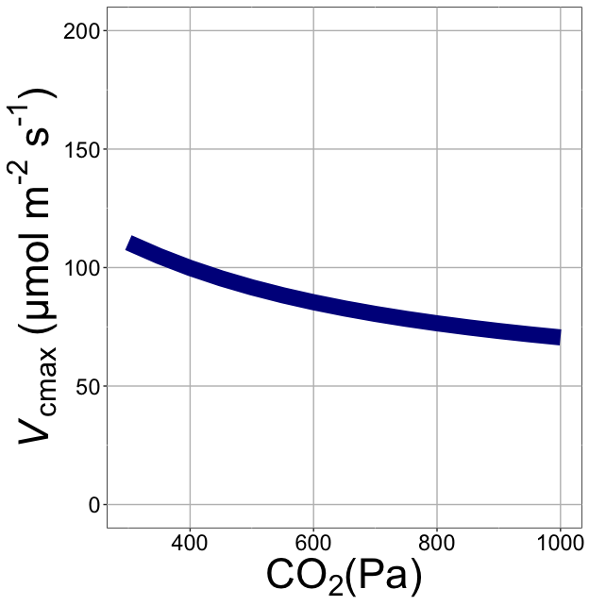
nick.smith@ttu.edu; @nick_greg_smith
V_{cmax} decreases with CO₂ because of greater CO₂ in the leaf
(ppm)
Smith et al. (2019)

Slide 21
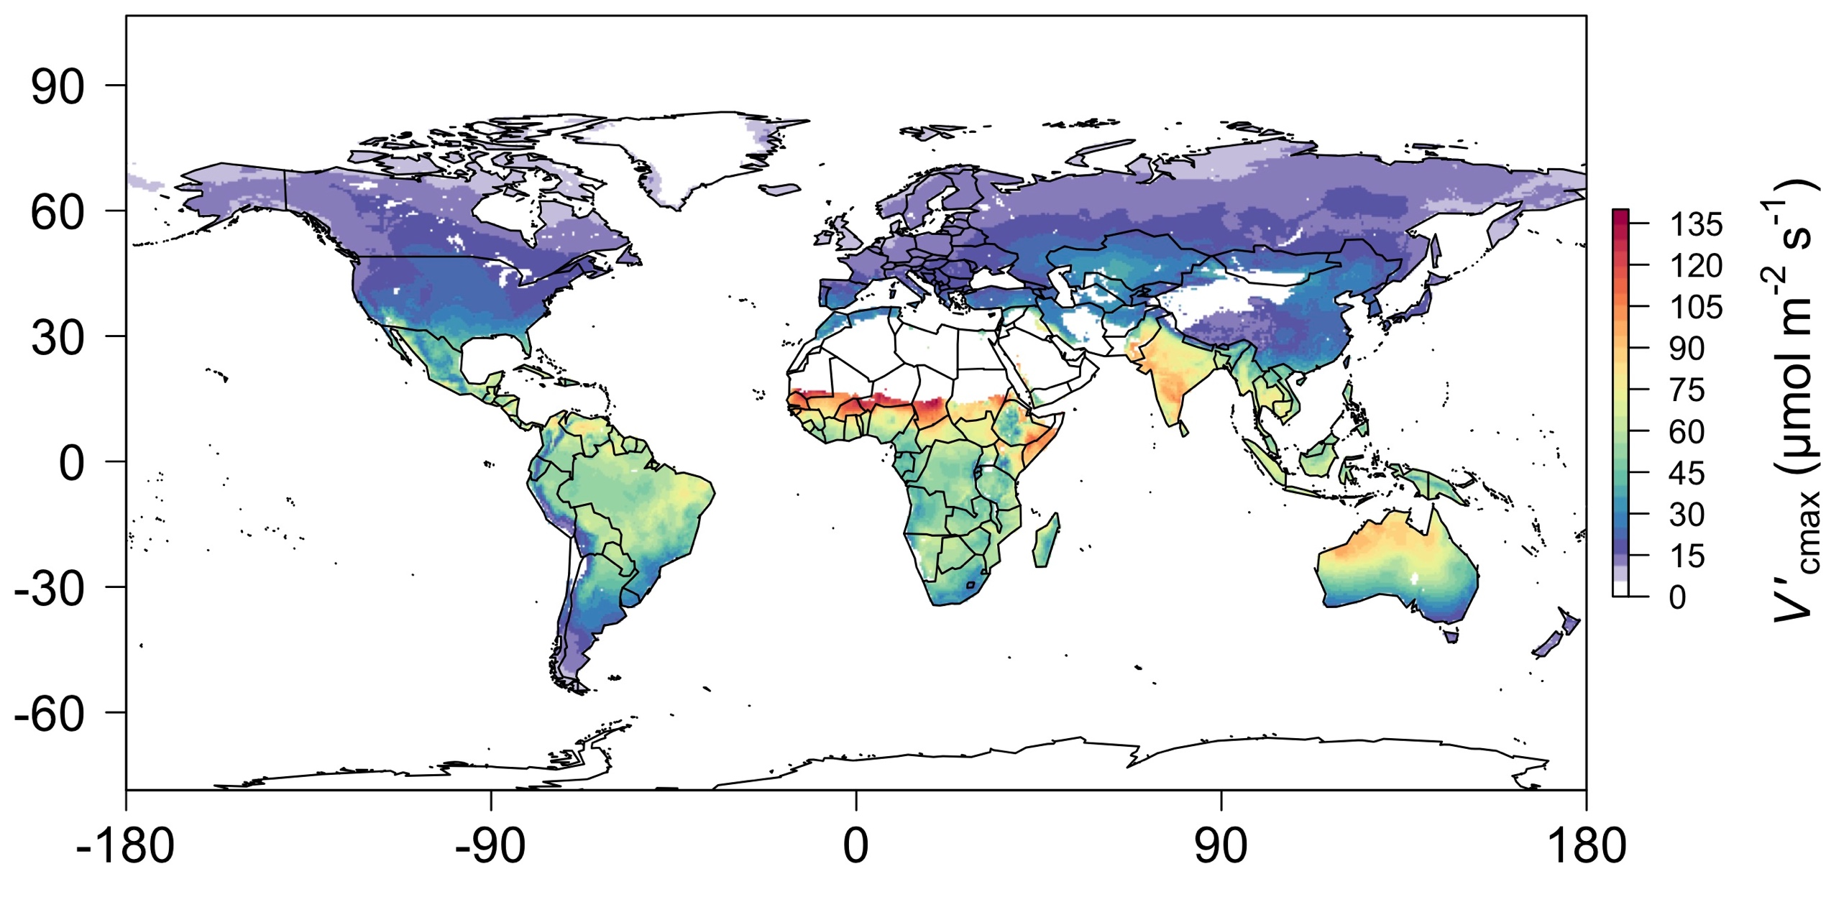
nick.smith@ttu.edu; @nick_greg_smith
Global, optimally acclimated traits!
Smith et al. (2019)

Slide 22
Important note: least-cost optimality model adds no free parameters to Farquhar model and dynamically predicts most
nick.smith@ttu.edu; @nick_greg_smith

Slide 23
Important note: adds acclimation, while reducing parametric uncertainty
nick.smith@ttu.edu; @nick_greg_smith

Slide 24

Let’s run a model out into the future!
nick.smith@ttu.edu; @nick_greg_smith

Slide 25
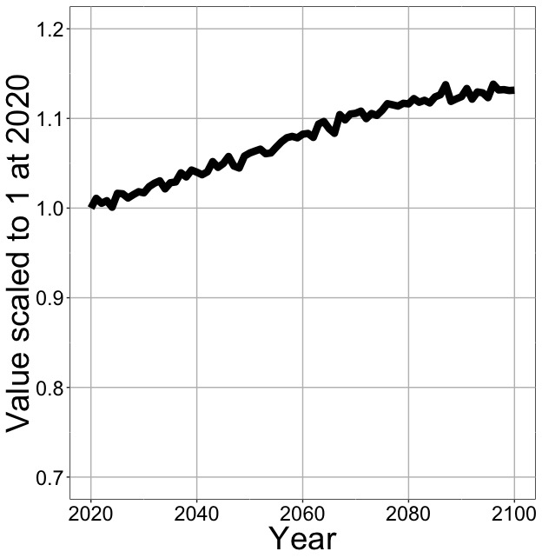
Photosynthesis increases in future
nick.smith@ttu.edu; @nick_greg_smith
Net Photosynthesis
Smith et al. (in prep)

Slide 26
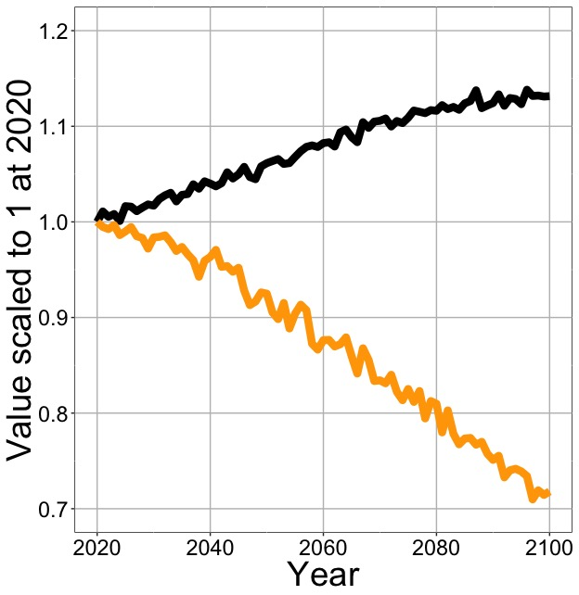
Photosynthesis increases in future (at lower nutrient use)
nick.smith@ttu.edu; @nick_greg_smith
Net Photosynthesis
Leaf Nitrogen
Smith et al. (in prep)

Slide 27
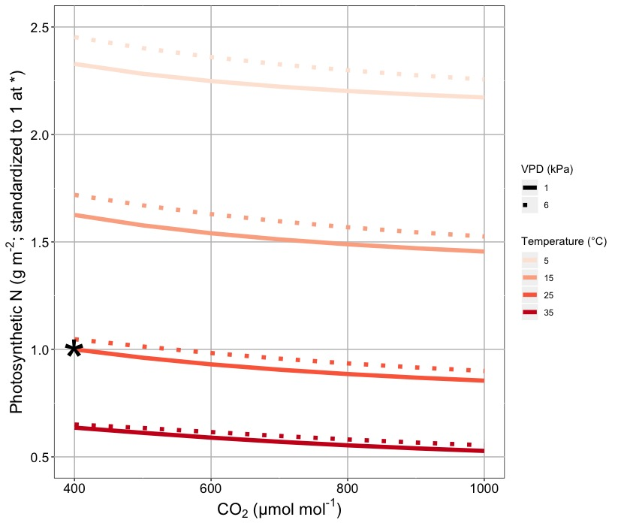
Leaf N declines due to warming and eCO₂
nick.smith@ttu.edu; @nick_greg_smith
Smith & Keenan (in review)

Slide 28
Photosynthesis increases in future (at lower nutrient use)
nick.smith@ttu.edu; @nick_greg_smith
Net Photosynthesis
Leaf Nitrogen
Smith et al. (in prep)

Slide 29
Photosynthesis increases in future (at lower nutrient use)
nick.smith@ttu.edu; @nick_greg_smith
Net Photosynthesis
Base ELM shows <5% change in leaf N
Leaf Nitrogen
Smith et al. (in prep)

Slide 30
What does this all mean and is it real?
nick.smith@ttu.edu; @nick_greg_smith

Slide 31
A typical LSM photosynthesis scheme
nick.smith@ttu.edu; @nick_greg_smith
Climate
Soil N
Leaf N
Photosynthesis

Slide 32
Least cost optimality model
nick.smith@ttu.edu; @nick_greg_smith
Climate
Photosynthesis

Slide 33
Let’s check this assumption
nick.smith@ttu.edu; @nick_greg_smith
Climate
Soil N
Leaf N
Photosynthesis

Slide 34
Does leaf N respond to soil N?
nick.smith@ttu.edu; @nick_greg_smith
Each box is proportional to the variance in leaf N explained by each variable
Smith et al. (in prep)

Slide 35
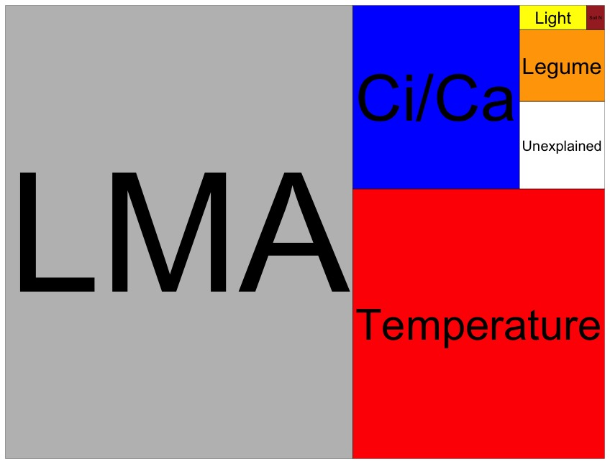
Globally, N addition little impact on leaf N
nick.smith@ttu.edu; @nick_greg_smith
Each box is proportional to the variance in leaf N explained by each variable
Smith et al. (in prep)

Slide 36
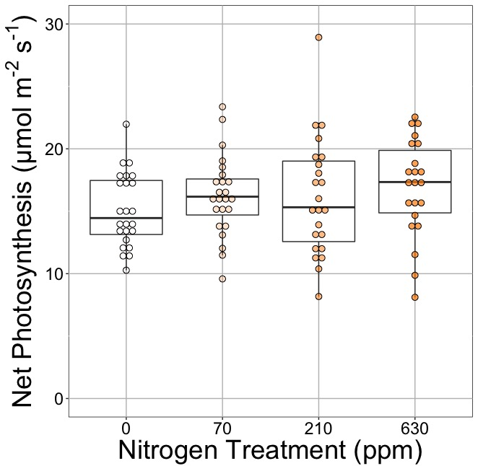
Does photosynthesis respond to soil N?
nick.smith@ttu.edu; @nick_greg_smith
Waring and Smith (in prep)

Slide 37
Photosynthesis does not change with soil N
nick.smith@ttu.edu; @nick_greg_smith
No change (P = 0.42)
Waring and Smith (in prep)

Slide 38
How does the optimality model do?
nick.smith@ttu.edu; @nick_greg_smith
Climate
Photosynthesis

Slide 39

nick.smith@ttu.edu; @nick_greg_smith
Optimal V_{cmax} is similar to observed values
Smith et al. (2019)

Slide 40
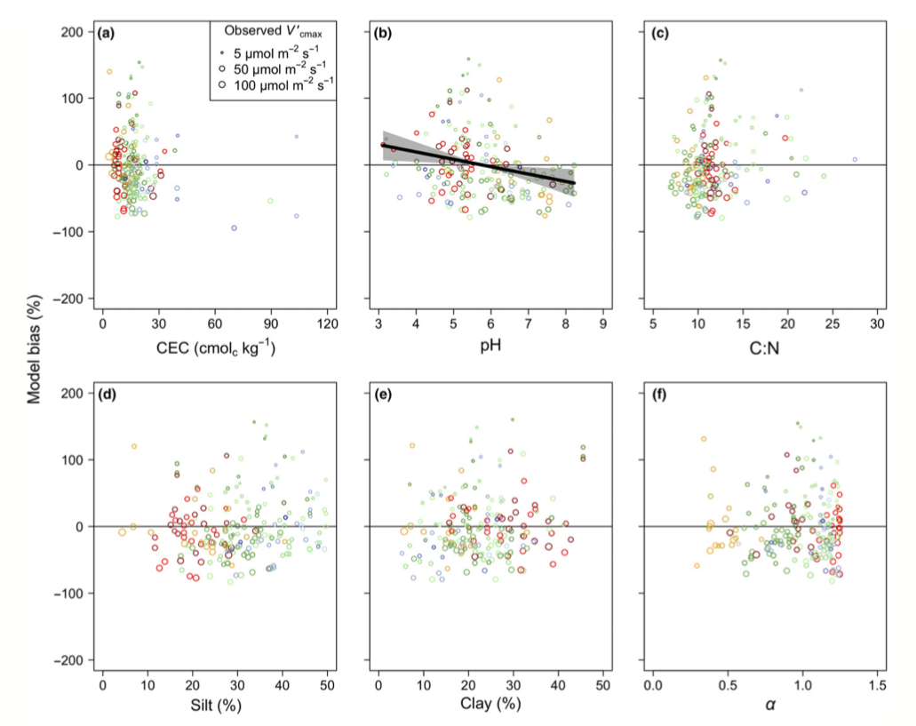
There is little effect of soils on V_{cmax}
nick.smith@ttu.edu; @nick_greg_smith
Soil increased explained variation from 64% to 68% compared to optimal response alone
Smith et al. (2019)

Slide 41
Does it work under future conditions?

Slide 42
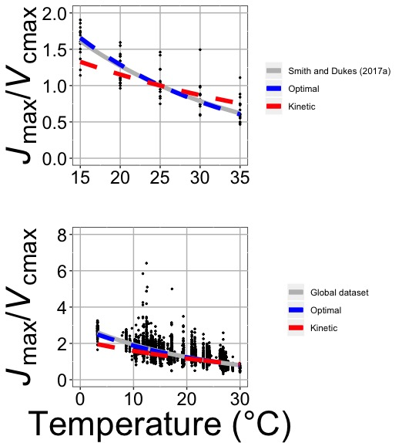
Photosynthetic traits change with temperature in ways expected from optimization
nick.smith@ttu.edu; @nick_greg_smith
Data = -0.051 °C⁻¹
Predicted = -0.048 °C⁻¹
Smith and Keenan (in review)

Slide 43
Photosynthetic traits change with future conditions in ways expected from optimization
nick.smith@ttu.edu; @nick_greg_smith
mean: -12%
mean: -15%
(P > 0.05)
Smith and Keenan (in review)

Slide 44
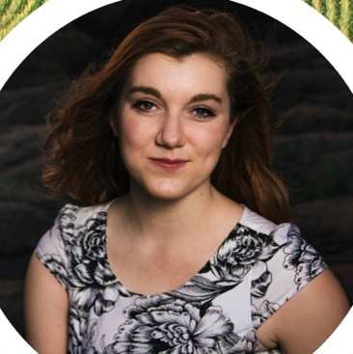
We now have an acclimation model for C₃ and C₄ species!
Helen Scott
TTU

Slide 45
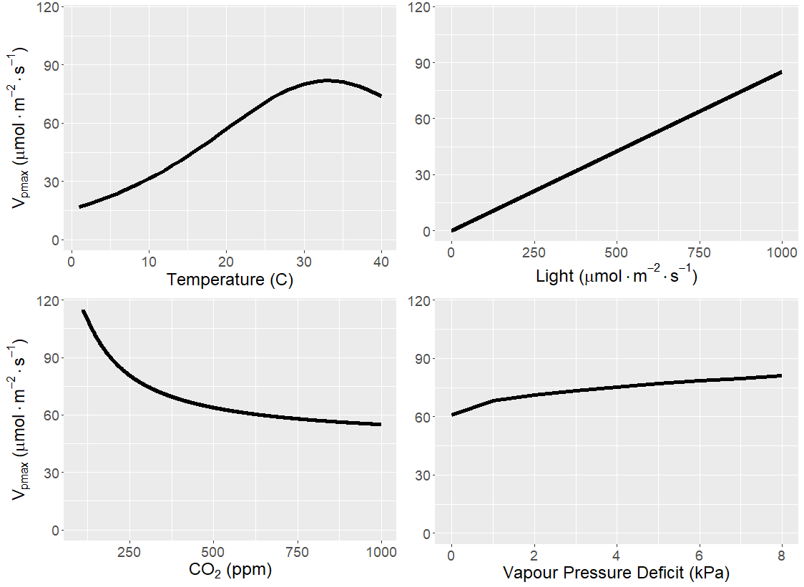
Photosynthetic biochemistry responds similarly in C₄ leaves as C₃ leaves
Scott and Smith (in prep)

Slide 46
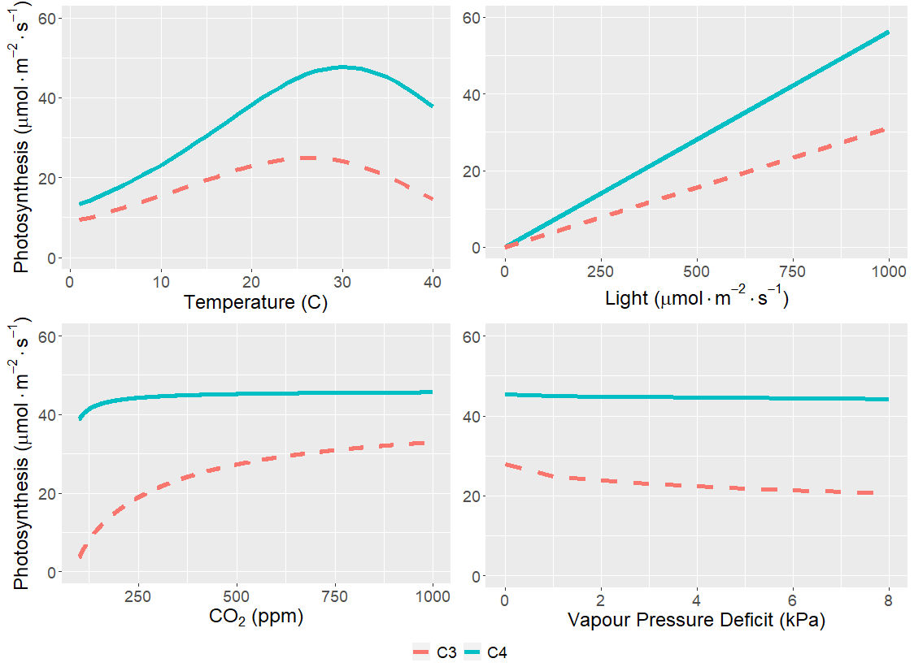
As expected, C₄ species are most benefitted under hot, dry, low CO₂ conditions
Scott and Smith (in prep)

Slide 47
Important model assumptions

Slide 48
Implications
Optimal leaf biochemical setup is determined by climate

Slide 49
Implications
Optimal leaf biochemical setup is determined by climate
Plants mine for N to get the most leaves at the optimal setup

Slide 50
Implications
Optimal leaf biochemical setup is determined by climate
Plants mine for N to get the most leaves at the optimal setup
Photosynthetic demand determines leaf N, not the other way around

Slide 51
Axes need flipped
Kattge et al. (2009)

Slide 52
Implications
Optimal leaf biochemical setup is determined by climate
Plants mine for N to get the most leaves at the optimal setup
Photosynthetic demand determines leaf N, not the other way around
Soil N determines biomass investment

Slide 53
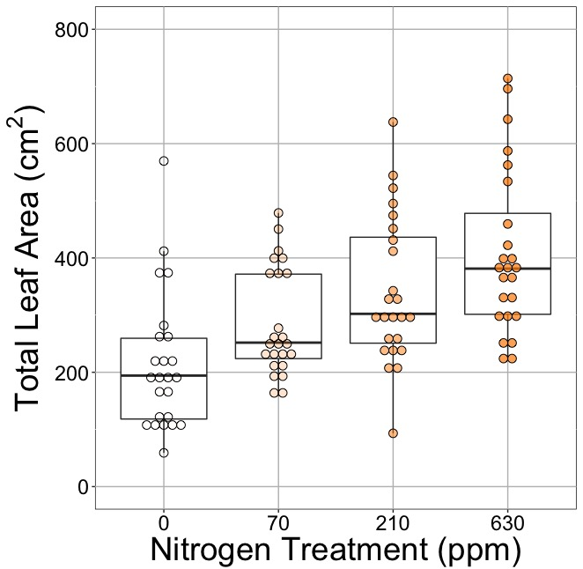
Soil N determines # of leaves?
nick.smith@ttu.edu; @nick_greg_smith
No change (P = 0.42)
91% increase (P < 0.05)
Waring and Smith (in prep)

Slide 54
FATES implementation

Slide 55
FATES implementation
No new parameters beyond Farquhar et al. (1980; C3) and Von Caemmerer (2000; C4)
Will need running mean environmental conditions (8 new lines of code)
More tractable code?

Slide 56
FATES implementation
No new parameters beyond Farquhar et al. (1980; C3) and Von Caemmerer (2000; C4)
Will need running mean environmental conditions (8 new lines of code)
More tractable code?
How to get variation in traits within a gridcell?
Need variation in environment the leaves are experiencing

Slide 57
FATES implementation
No new parameters beyond Farquhar et al. (1980; C3) and Von Caemmerer (2000; C4)
Will need running mean environmental conditions (8 new lines of code)
More tractable code?
How to get variation in traits within a gridcell?
Need variation in environment the leaves are experiencing
Cool resulting science questions
C3/C4 competition
Allocation responses
Nutrient feedbacks (whole plant and ecosystem)

Slide 58
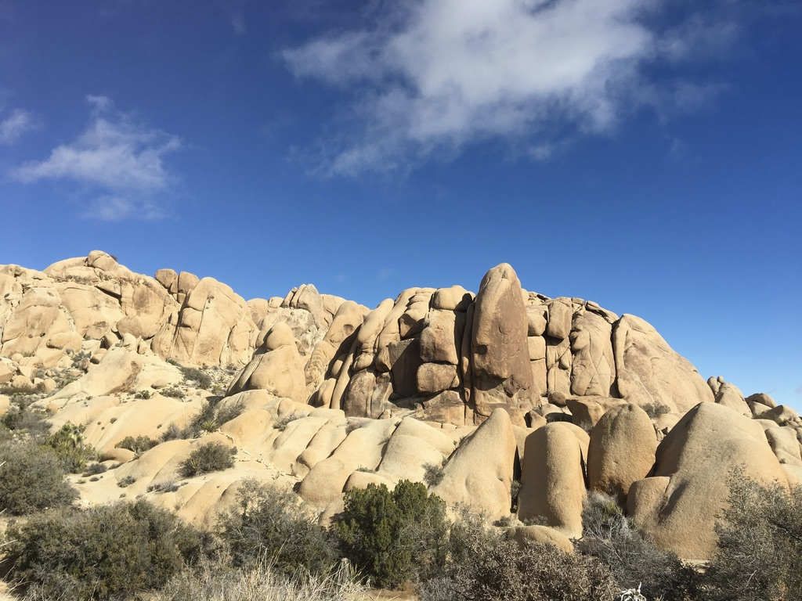
nick.smith@ttu.edu; @nick_greg_smith
Presentation available at:
www.github.com/SmithEcophysLab/seminar/2020_fates
Thanks!

Slide 59
Extra slides

